Slide 1



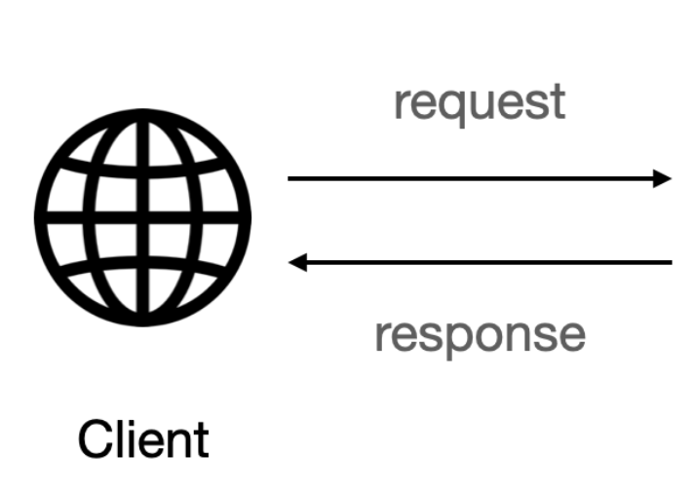




GET response to request for the Forcast
Serves the GET Request
Serves the POST resquet
Serves the PUT resquet
POST /PUT response with the Forcast
Serves the DELETE resquet

